Slide 1
Exploring the Design and Flaws of Machine Learning Technology By Analyzing Compiled Jail Datasets
Andrew Dass
11/8/20

Slide 2
Introduction to what is Machine Bias
Machine Learning Software (1) is used nationwide to detect the threat level a prisoner possesses
Their threat level is ranked from a scale 1 to 10
There are many factors that determine the threat level which is not shared to the public
Due to the lack of information how machine learning software calculates the threat level, people claim this software is not accurate when judging specific people (1) and refer to this as Machine Bias
However, nowadays some studies’ data from years ago are being published and available online for people to analyze
(#) show information cited from sources

Slide 3
Problem
Data (2) from previous jails can show or prove if this software to detect a prisoner’s threat level was rigged
Data being analyzed is based off of age, gender, ethnicity and more characteristics
Ultimately, claims or sources state people that are not white are more at risk of being a threat despite what crimes they did, especially black people
This data (2) from the years will be analyzed to determine whether developed software was rigged to detect a prisoner’s threat level

Slide 4
Hypothesis
Personally, I believe the machine bias was not programmed properly therefore it malfunctions when giving a person’s threat level by judging them on their physical appearance
Maybe the software was rigged to give high scores to certain people since the law wants to keep their prisoners to remain in jail and not endanger society

Slide 5
Procedure
Two data sets from credible sources (2) will be analyzed thoroughly: Compas-Scores and Cox-Violent Parsed
After analyzing the data will determine whether machine bias is an issue
Slides that contain graphs have the code in the notes section, under the slide for convenience

Slide 6
Compas-Scores Data
The Compas-Scores Data Set has many columns of data including:
Rawscore – The lower this score is for the individual, the more of a threat they are
Decilescore – The higher this person’s score, the higher of a threat they are
Ethnicity – Observe how many people of the same origins were in jail and from the data, see if they were treated differently from different ethnic groups
Gender – Analyze any differences if males and females were assigned different scores from one another
Scale_ID – A number prisoners were assigned due to their threat level

Slide 7
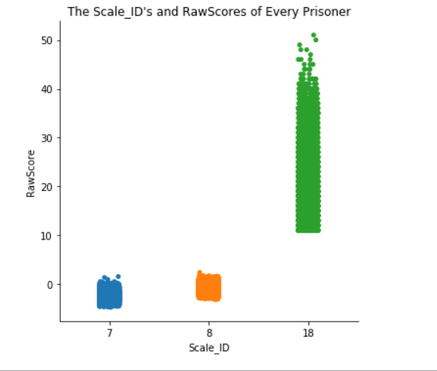
Compas-Scores Data: Scale_ID vs Raw Score
To the side shows prisoners were assigned either 7, 8 or 18 as their scale id’s when given their raw score
It seems people who have a negative number and around 0, have the scale id 7
People given the scale id 8 seems to have slightly higher raw scores than those with the scale id 7
Everyone else with scale id 18 has raw scores from greater 11 to 50
Notes:
import seaborn as sns
import matplotlib.pyplot as plt
import pandas as pd
Data = pd.read_csv('data/compas-scores-raw.csv', skiprows = False)
plot = sns.catplot(x="Scale_ID", y="RawScore", data = Data)
plt.title("The Scale_ID's and RawScores of Every Prisoner")

Slide 8
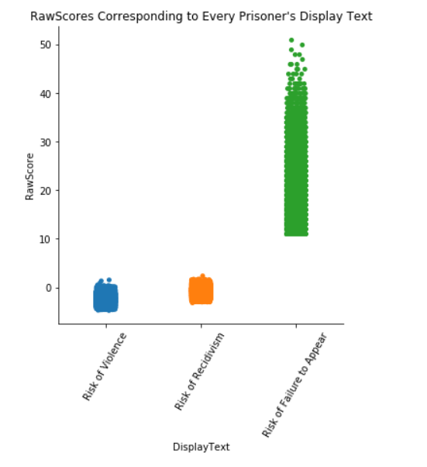
Compas-Scores Data: Displaytext vs Raw Score
The catplot graph shown to the right is similar from the previous slide.
The only difference is the x-axis now shows the “DisplayText”
There are 3 options: Risk of Violence, Risk of Recidivism, and Risk of Failure to Appear which associates with scale id’s 7, 8, and 18 respectively
Notes:
import seaborn as sns
import matplotlib.pyplot as plt
import pandas as pd
Data = pd.read_csv('data/compas-scores-raw.csv', skiprows = False)
plot = sns.catplot(x="DisplayText", y="RawScore", data = Data)
plt.title("RawScores Corresponding to Every Prisoner's Display Text")
plt.xticks(rotation=60)

Slide 9
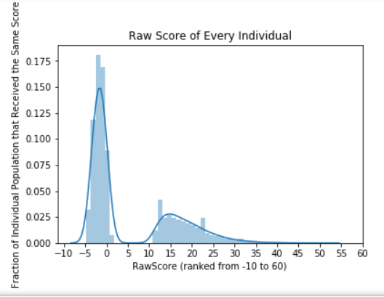
Compas-Scores Data: Raw Score of Individuals
To the side shows a distplot, of every prisoner’s Raw Score
Many people happened to receive a negative number or near 0, indicating they are a threat
There are a few prisoners that scored between 10 to 35
Not much people scored higher than 35, indicating they are the least dangerous prisoners according to the data
Notes:
import seaborn as sns
import matplotlib.pyplot as plt
import pandas as pd
import numpy as np
Data = pd.read_csv('data/compas-scores-raw.csv', skiprows = False)
sns.distplot(Data['RawScore'])
plt.title(f"Raw Score of Every Individual")
plt.xlabel("RawScore (ranked -10 to 50)")
plt.ylabel("Fraction of Individual Population that Received the Same Score")
plt.xticks(np.arange(-10, 61, 5))

Slide 10
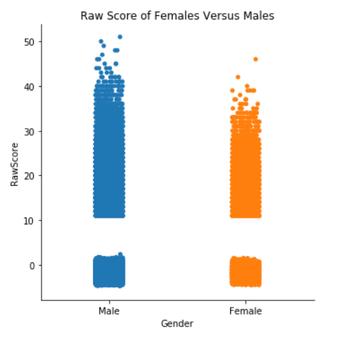
Compas-Scores Data: Raw Score of Females and Males
The catplot graph shown to the right is to showcase how many men and women were in jail
It seems there might be more men than women in this study
This graph also shows, despite your gender, many people were given a variety of raw scores from the range they were giving.
Men seemed to score higher raw scores proving they were innocent though there is no evidence to showcase why
Notes:
import seaborn as sns
import matplotlib.pyplot as plt
import pandas as pd
Data = pd.read_csv('data/compas-scores-raw.csv', skiprows = False)
plot = sns.catplot(x="Sex_Code_Text", y="RawScore", data = Data)
plt.title("Raw Score of Females Versus Males")
plt.xlabel("Gender")

Slide 11
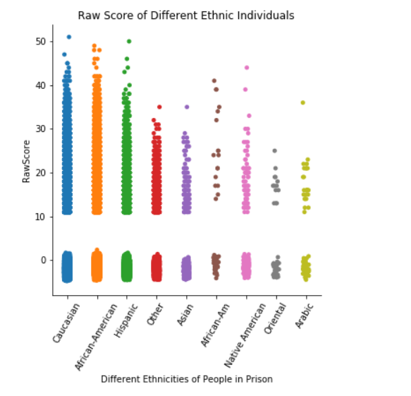
Compas-Scores Data: Ethnicity vs Raw Score
To the right shows a catplot graph showing the different ethnicities of all the prisoners in this study
It seems many people of every ethnicity was given many different raw scores
From observing the data, it is strange that African-American was labeled twice in the data as “African-American” and “African-Am”
Is there a reason they made two columns African Americans to separate them for classified information?
There is also an “other” column which may include more or the ethnicities already shown
Notes:
import seaborn as sns
import matplotlib.pyplot as plt
import pandas as pd
Data = pd.read_csv('data/compas-scores-raw.csv', skiprows = False)
plot = sns.catplot(x="Ethnic_Code_Text", y="RawScore", data = Data)
plt.title(f"Raw Score of Different Ethnic Individuals")
plt.xticks(rotation=60)
plt.xlabel("Different Ethnicities of People in Prison")
plt.figure(figsize=(20,50))

Slide 12
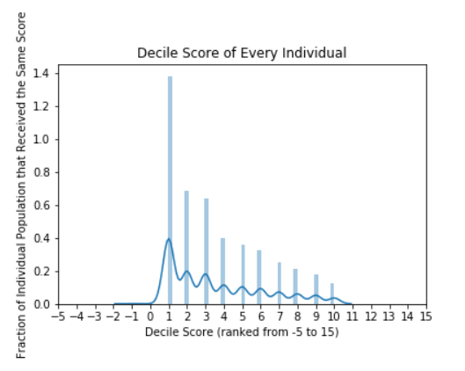
Compas-Scores Data: Decile Score of Individuals
To the right shows a distplot for every prisoner’s decile score
The higher the decile score, the more of a risk the person is
The y-axis shows a fraction of the entire population received that score. Ex: 0.4 or 40% of the prisoners received a decile score of 1.
Notes:
import seaborn as sns
import matplotlib.pyplot as plt
import pandas as pd
import numpy as np
Data = pd.read_csv('data/compas-scores-raw.csv', skiprows = False)
sns.distplot(Data['DecileScore'])
plt.title(f"Decile Score of Every Individual")
plt.xlabel("Decile Score (ranked from -5 to 15)")
plt.ylabel("Fraction of Individual Population that Received the Same Score")
plt.xticks(np.arange(-5, 16, 1))

Slide 13
Data(Compas-Scores Data Continued)
The lower your raw-score is, the higher chance you are indicated of being a risk
From the looks of it, most of the population is consisted of Caucasian and African-American people
From the ethnicity chart, there are two columns for African-Americans
Since the dots are small, they can overlap in the graphs and prove which ethnic population has the most people in this jail study
From observing the data, there is not a justifiable reason to have two columns for African-Americans

Slide 14
Cox-Violent Parsed
This study has the following columns of data:
Person’s Violent Score – Characterized as Low, Medium or High of being a threat
V_Decile (Violent Decile) Score – A score given to prisoners from 1 to 10
id – A unique entry given to every new person that enters prison. Can show the total amount of people in prison.
Gender – See how many women or men were in jail

Slide 15
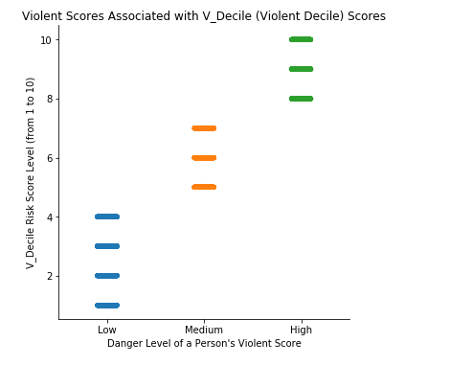
Cox-Violent Parsed: Person’s Violent Score (Violent Decile Scores (4)) and Risk
To the right shows a catplot of prisoners’ danger level in correspondence to their violent score
The higher the prisoner’s violent score, the greater of a risk they are
There are 3 danger levels: Low, Medium and High.
Violent scores range from 1 to 10
Low danger levels score between 1 to 4
Medium danger levels score between 5 to 7
High danger levels score between 8 to 10
Notes:
import seaborn as sns
import matplotlib.pyplot as plt
import pandas as pd
Data = pd.read_csv('data/cox-violent-parsed.csv', skiprows = False)
plot = sns.catplot(x="v_score_text", y="v_decile_score", data = Data)
plt.title("Violent Scores Associated with V_Decile (Violent Decile) Scores")
plt.xlabel("Danger Level of a Person's Violent Score")
plt.ylabel("V_Decile Risk Score Level (from 1 to 10)")

Slide 16
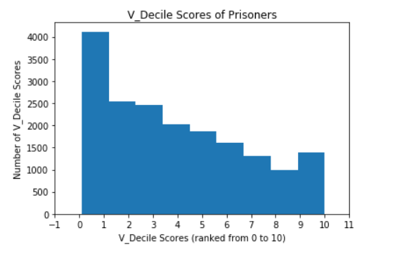
Cox-Violent Parsed: The amount of each V_Decile Score (Violent Decile Scores) Given
Shown to the right is a histogram showing how many of each V_Decile Score was given
It seems 1 was given the most, and 4000 people received that score
It seems the score 9 has been given the least
Notes:
import matplotlib.pyplot as plt
import seaborn as sns
import pandas as pd
Data = pd.read_csv('data/cox-violent-parsed.csv', skiprows = False)
plt.xlabel('V_Decile Scores (ranked from 0 to 10)')
Data['v_decile_score'].plot(kind='hist')
plt.ylabel('Number of V_Decile Scores')
plt.title('V_Decile Scores of Prisoners')
plt.xlim([0, 10])
plt.xticks(np.arange(-1, 12, 1))

Slide 17
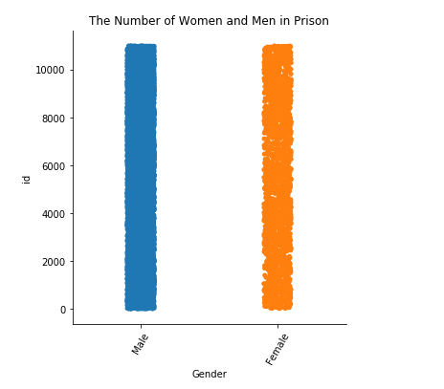
Cox-Violent Parsed: Amount of Women and Men in Prison
To the right is a catplot showing the total amount of men and women respectively in this study.
The y-axis or id, gives a unique entry for every person that stayed in this prison for the data set
Using the id can give us an estimate, how much men and women were in jail
About more than 10,000 men and women are in this study.
Notes:
import seaborn as sns
import matplotlib.pyplot as plt
import pandas as pd
Data = pd.read_csv('data/cox-violent-parsed.csv', skiprows = False)
plot = sns.catplot(x="sex", y="id", data = Data)
plt.title("The Number of Women and Men in Prison")
plt.xticks(rotation=60)
plt.xlabel("Gender")
plt.ylabel("id")
plt.figure(figsize=(20,50))

Slide 18
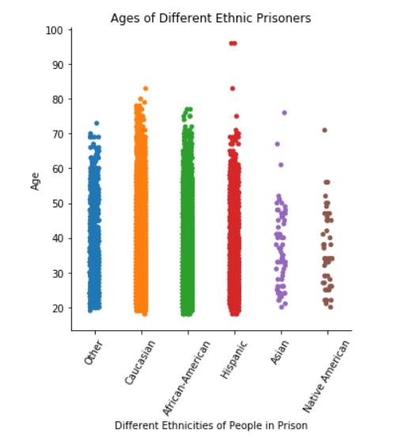
Cox-Violent Parsed: Ages of Different Ethnic Prisoners
To the right is a catplot showing the ages and ethnicities of everyone in this jail study
This study seems to be less vague about their ethnic options
They specify an “Other” column, which can include or not include some ethnic people that are shown on the graph
Notes:
import seaborn as sns
import matplotlib.pyplot as plt
import pandas as pd
Data = pd.read_csv('data/cox-violent-parsed.csv', skiprows = False)
plot = sns.catplot(x="race", y="age", data = Data)
plt.title(f"Ages of Different Ethnic Prisoners")
plt.xticks(rotation=60)
plt.xlabel("Different Ethnicities of People in Prison")
plt.ylabel("Age")
plt.figure(figsize=(20,50))

Slide 19
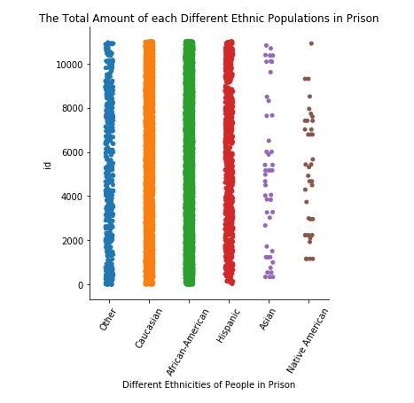
Cox-Violent Parsed: Total Amount of Each Different Ethnic Populations in Prison
To the right shows all the different ethnic groups
It seems there are that much Asian and Native American people
However, there is an other column that can contain any of these columns that were listed or not listed
There happens to be many Caucasian, African-American, and Hispanic people
Notes:
import seaborn as sns
import matplotlib.pyplot as plt
import pandas as pd
Data = pd.read_csv('data/cox-violent-parsed.csv', skiprows = False)
plot = sns.catplot(x="race", y="id", data = Data)
plt.title(f"The Total Amount of each Different Ethnic Populations in Prison")
plt.xticks(rotation=60)
plt.xlabel("Different Ethnicities of People in Prison")
plt.ylabel("id")
plt.figure(figsize=(20,50))

Slide 20
Results
Both data sets seems to show some kind of correlation, why many people of different ethnic groups may have received the score they did
There were also some concerns, such as the Compas dataset having two African-American columns. Combining both of them into one column probably would show that the most prisoners in that study were African-Americans.
The Cox-Violent Parsed dataset showed most of the prisoners are Caucasian, African-American, and Hispanic people

Slide 21
Conclusion
The data shows sufficient evidence that there might be an implementation issue for their machine learning software
People would argue two datasets is not enough evidence or data to conclude other jails follow these rules or criteria when labeling their prisoners as risks like these two studies do
On the contrary, there is always the possibility this scenario can happen in many places we do not know of and people are being treated poorly.
Each study had their own data columns, so maybe every jail has their own unique method of characterizing their prisoners
Both datasets may have shown data that many of their prisoners, men or women of different ethnic origins, can receive a low or high raw and decile scores
Graphing the scores for both datasets may have had many overlaps of the same points or coordinates, so it is hard to say which ethnic group populated each study the most by glancing at the graphs

Slide 22
Conclusion (Compas-Scores Data)
The Compas dataset had two African-American columns which created suspicion in their dataset since the reason for this was not explained
By making two columns, they wanted to hide the fact that African-Americans may have been the most populated ethnic group in these two studies
The machine learning technology they used may have been rigged to give high scores to Africans most likely, so they remain in jail and the people in charge of the prisons may have their reasons why they did this

Slide 23
Conclusion (Cox-Violent Parsed)
From the cox-violent parsed dataset, most of the prisoners were Caucasian African American and Hispanic
Since there are a lot of Caucasian, African-Americans and Hispanic people, this fact does not prove they are treated the same in jail
Probably for the cox-violent dataset, that area where the prison is, most people that live there are either of that ethnicity so they would be arrested and sent there or the most dangerous criminals from across the whole world were sent there
Referring to the title of the experiment “Cox-Violent Parsed” means to analyze the danger of the individuals in this jail for the study, and once again, many of the prisoners are Caucasian, African-American, and Hispanic
There may be a reason why many of these people were sent to this prison, but why were they considered dangerous? There were not many Asian or Native American people.
Despite there were not many Asian or Native American people, and seeing so many Caucasian, African-American and Hispanic people may create suspicion, the original Cox-Violent Parsed dataset explained why every person was arrested for their crimes
Some arrests included battery, driving under the influence, possession of illegal drugs and much more
Since there are so many African-Americans in jail, the machine learning technology they use may have been wired to purposely give bad readings to them, since they want them to remain in jail and not cause more crimes outside of jail

Slide 24
Sources
https://www.propublica.org/article/machine-bias-risk-assessments-in-criminal-sentencing (1)
https://www.kaggle.com/danofer/compass (2)
https://prisonwriters.com/racism-in-prison/ (3)
https://investigate.ai/propublica-criminal-sentencing/week-5-1-machine-bias-class/ (4)

